Slide 1
Metagenomic Binning
By: Hoa Nguyen, John Seitz, Joshua shelly

Slide 2
What is Metagenomic Binning?
Metagenomic samples can contain reads from a large variety of organisms
For example, in a single sample of soil, there can be over 10,000 different types of organisms, of course each has its own unique genome
Typically the obtained sequences are not complete, which makes it hard to assemble individual genes, much less recovering the full genomes of each organism
Thus, binning techniques represent a "best effort" to identify reads / contigs with certain groups of organisms designated as OTUs

Slide 3
MetaBAT
- Automated binning software that uses empirical probabilistic distances of genome abundance and tetranucleotide frequency for accurate metagenome binning
- High accuracy and computational efficiency on both synthetic and real metagenome datasets.
- Forms hundreds of high-quality genome bins on a very large assembly consisting millions of contigs on a single node.
Notes:
An automated metagenome binning software that integrates empirical probabilistic distances of genome abundance and tetranucleotide frequency for accurate metagenome binning
It outperforms alternative methods in accuracy and computational efficiency on both synthetic and real metagenome datasets.
- It automatically forms hundreds of high-quality genome bins on a very large assembly consisting millions of contigs in a matter of hours on a single node

Slide 4
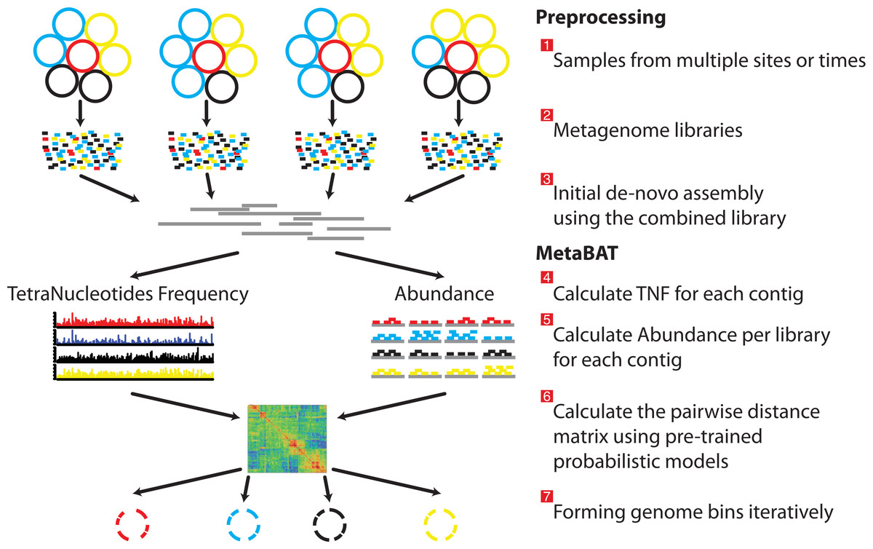
MetaBAT Pipeline
Notes:
First in the preprocessing step before using MetaBAT for binning
Gather sample from multiple site and variety of organism
Then parse them into a metagenome libraries and initialize it for processing with MetaBAT
Using MetaBAt it will calculate the TetraNucleotides Frequency probability distance and the Abundance distance probability
To generate the pairwise distance matrix and from accurate bin of each organism

Slide 5
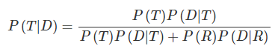
Tetranucleotide frequency probability distance (TDP)
T or R → Cases where two contigs are from different inter or the same intra species respectively
D → Euclidean TNF distance between two contigs

Slide 6
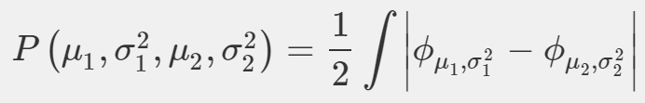
Abundance distance probability (ADP)
ϕ represents a normal distribution having two parameters μ and σ²
Notes:
Phi Mu Sigma
Mu mean coverage
Sigma variance
Suppose two contigs have the mean coverage of μ₁ and μ₂ and the variances of σ21σ12 and σ22σ22, then we defined the abundance distance as the non-shared area of two normal distributions of N(μ₁, σ21)σ12 and N(μ₂, σ22)σ22:

Slide 7
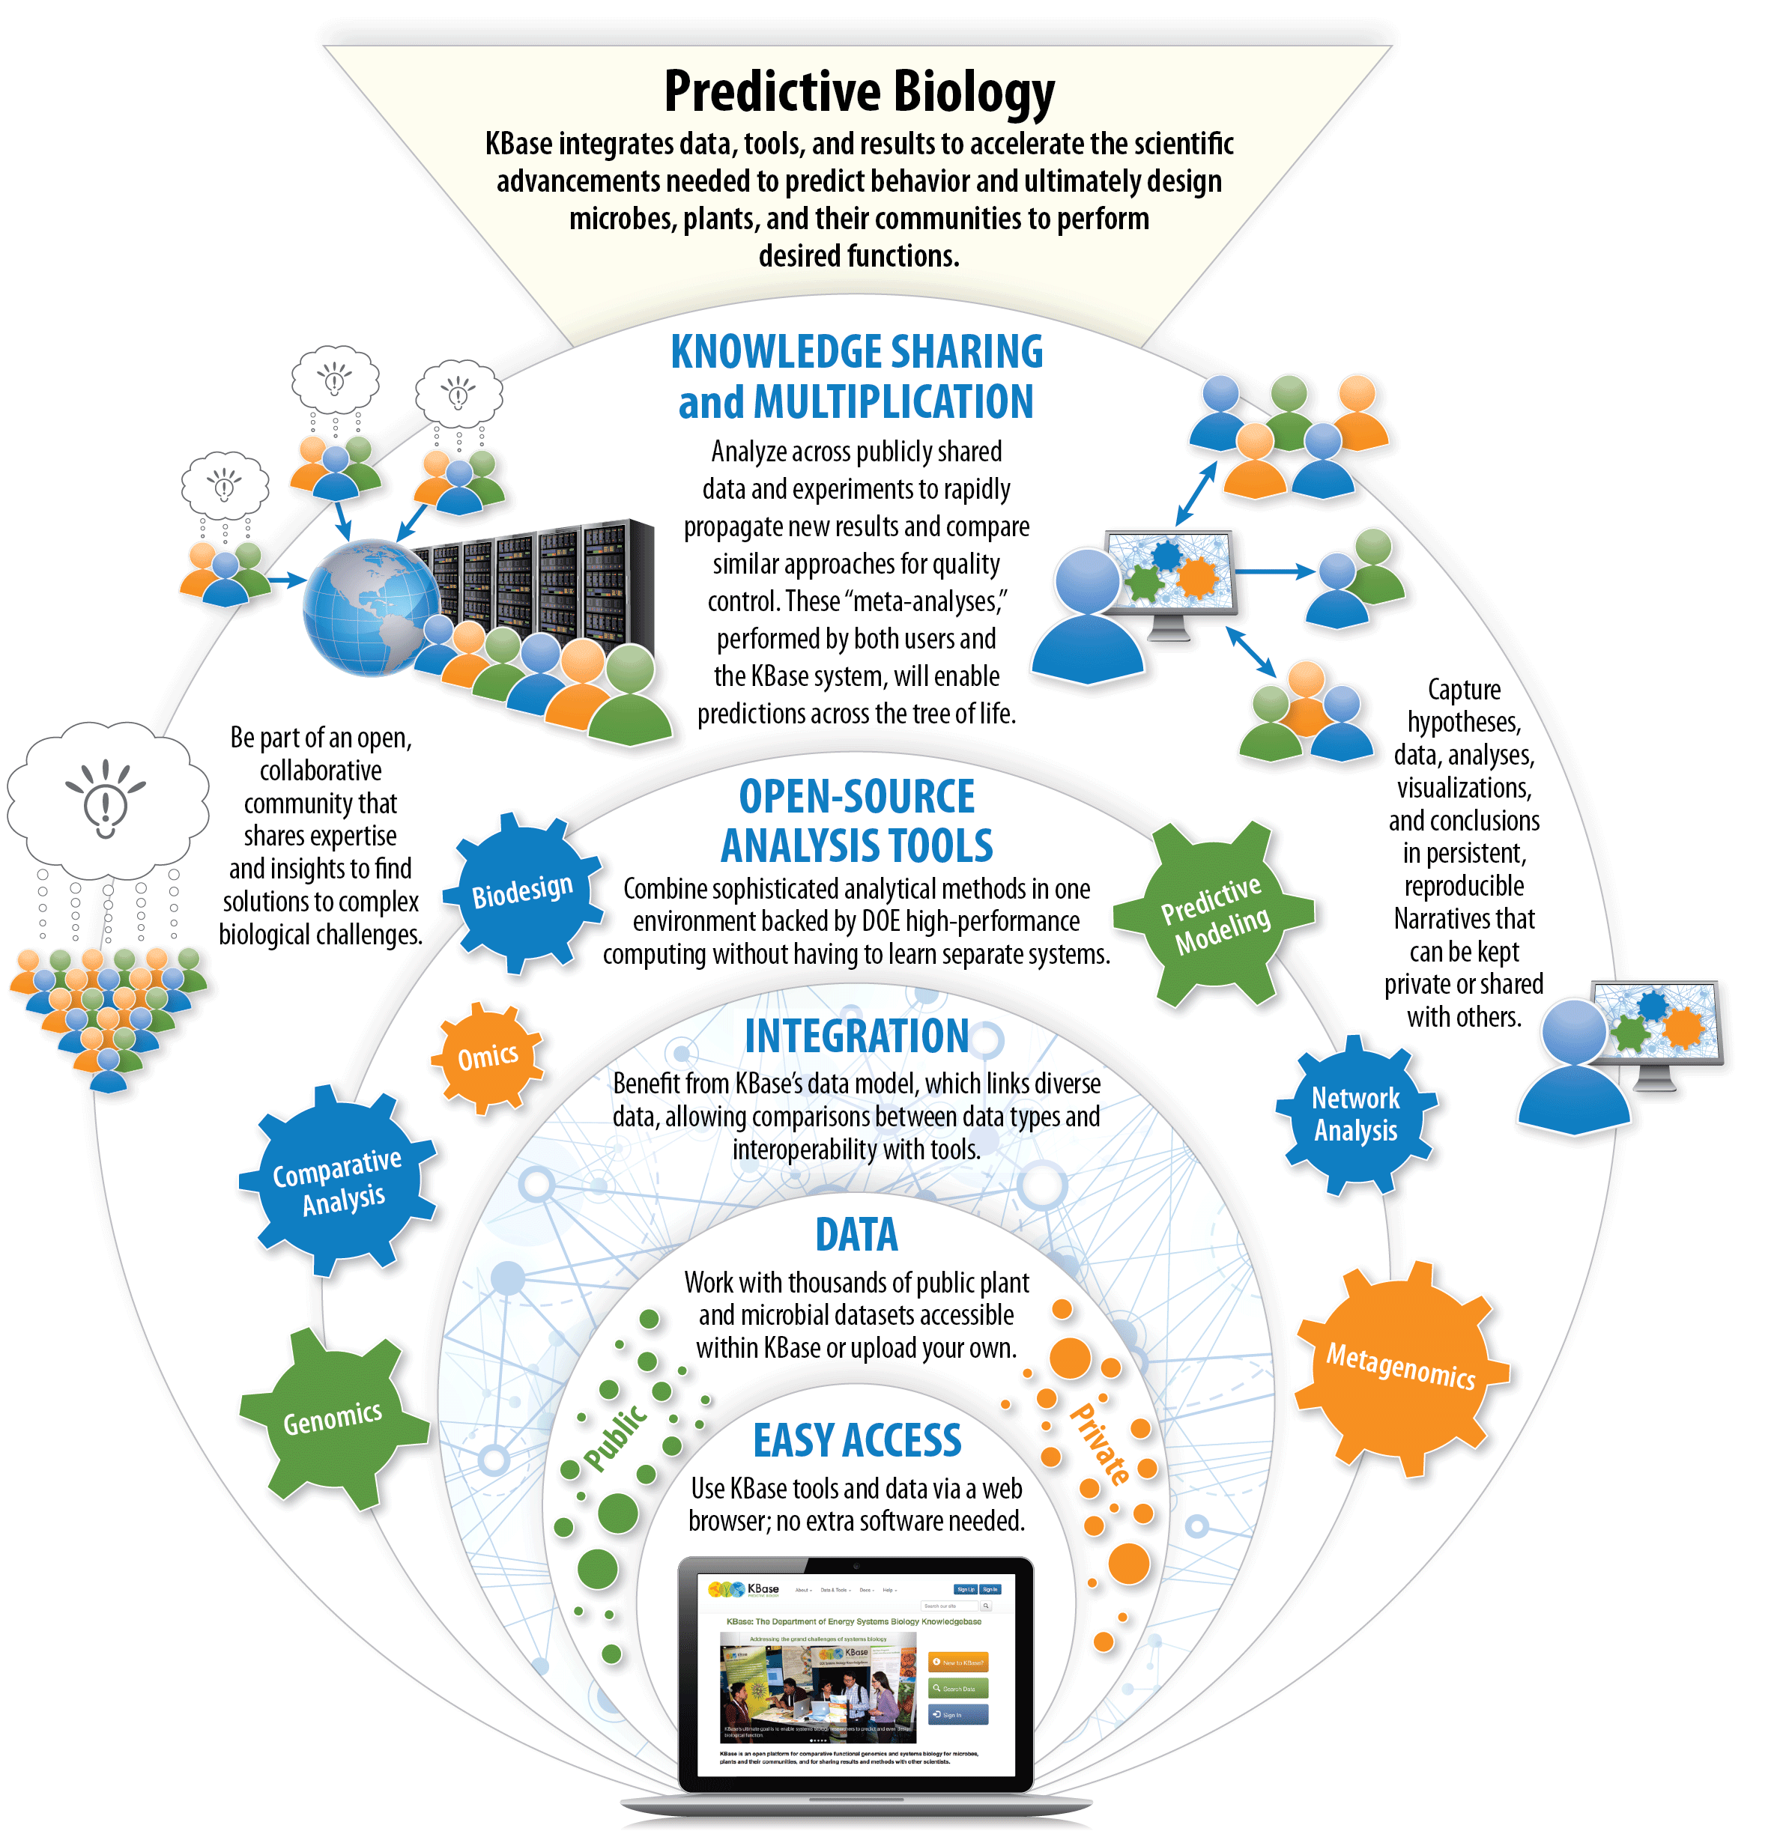
KBase
KBase is a free to use platform to analyze/model biological functions
Maintained by the U.S. Department of Energy – Systems Biology Knowledgebase
Integrates all tools/data/etc into a single GUI built off the Jupyter Notebook – extremely user friendly
Completely open source (on Github!) with relaxed usage requirements – can easily share results

Slide 8
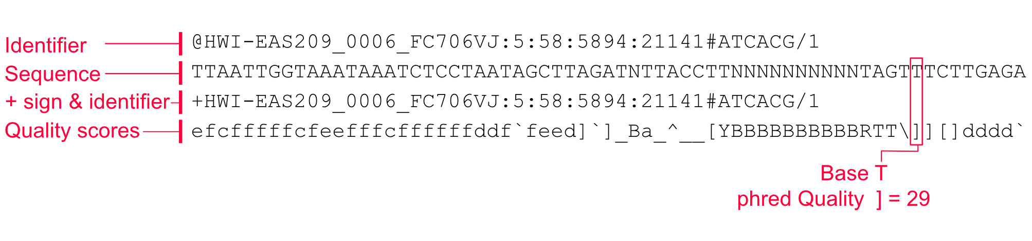
Kbase Demo Background
To begin binning, first make sure your data is in the correct formats (unzip first!)
KBase requires 1 Assembly file (in .FASTA format) and at least 2 Reads files (1 Forward, 1 Reverse to assemble into paired-end reads, must be in FASTQ format)
FASTQ is an extension of FASTA
Both file formats include description and sequence lines
FASTQ also includes quality scores for sequences – Cannot convert FASTA -> FASTQ

Slide 9
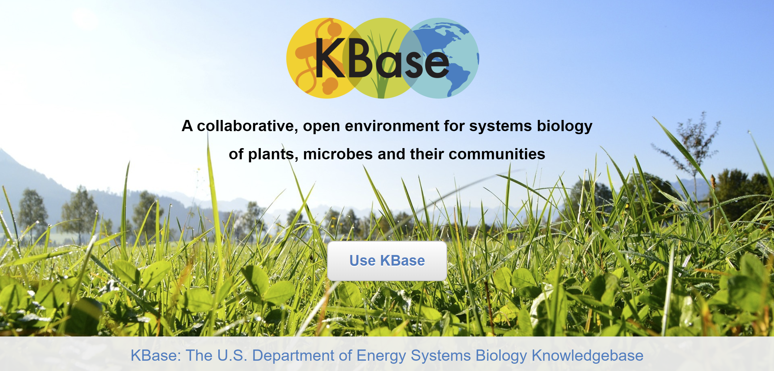
Kbase Binning Demo https://www.kbase.us/

Slide 10
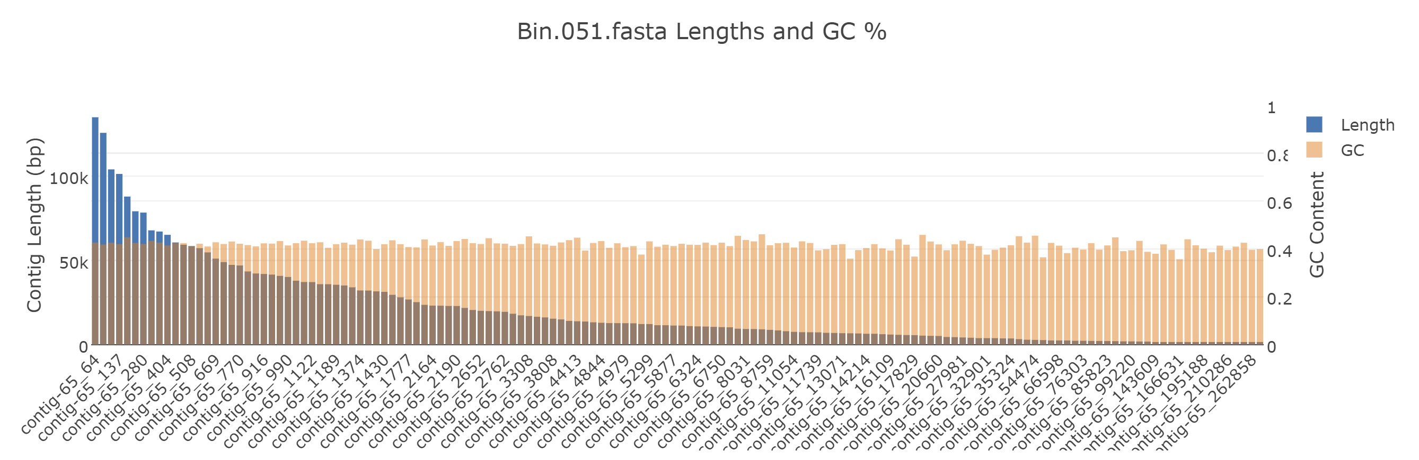
KBase Results
 | MetaBAT2 | MaxBin2
Input contigs: | 705871 | 705871
Binned Contigs: | 56704 (8.03%) | 213053 (30.18%)
Number of Bins: | 126 | 99
Run Time: | 3h 54m | 8h 18m
Visualization with CheckM

Slide 11

Proteus Binning Demo

Slide 12
References
1) Kang DD, Froula J, Egan R, Wang Z. 2015. MetaBAT, an efficient tool for accurately reconstructing single genomes from complex microbial communities. PeerJ 3:e1165 https://doi.org/10.7717/peerj.1165
2) Binning using MetaBAT and MaxBin from command line https://2017-cicese-metagenomics.readthedocs.io/en/latest/binning.html

